Slide 1


UNIT III
CLOUD DEPLOYMENT MODELS
Xen,
VMware,
Eucalyptus,
Amazon EC2,
KVM,
Virtual Box,
Hyper-V.

Slide 2
Vmware(type 2)
XEN (type 1) –
KVM (type 1)
VirtualBox (type 2)

Slide 3






Supports bridging existing host network adapters and share physical disk
drives and USB devices with a virtual machine.
It can simulate disk drives. It can mount an existing ISO image file into a virtual optical disc drive so that the virtual machine sees it as a real one. Likewise, virtual hard disk drives are made via .vmdk files
VMware Workstation can save the state of a virtual machine (a "snapshot") at any instant. These snapshots can later be restored, effectively returning the virtual machine to the saved state.

Slide 4
Virtual infrastructure
Virtual infrastructure is a collection of software-defined components that make up an enterprise IT environment. ... By decoupling physical hardware from an operating system, a virtual infrastructure can help organizations achieve greater IT resource utilization, flexibility, scalability and cost savings.

Slide 5
Infrastructure : Vmware Virtual machine file system(VMFS), Vmware Virtual Symmetric Multi processing(SMP), Virtual Infrestucture web access, Vmware Vmotion, Vmware Distributed Resource Scheduler

Slide 6


Storage And Arrays:Fiber Channel SAN arrays, iSCSI SAN arrays and NAS arrays are widely-used storage technologies supported by Vmware Infrastructure to meet different data center storage needs
Ip Networks: Each computing server can have multiple gigabit Ethernet network interface cards(NICs) to provide high bandwidth and reliable networking to the entire data center

Slide 7



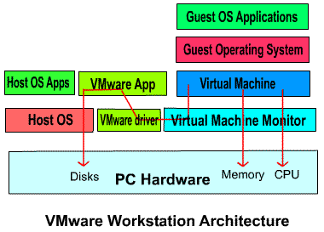

Slide 8
Virtual machine software
Virtual machine software from VMware (www.vmware.com) that allows multiple copies of the same operating system or several different operating systems to run in the same machine. For years, VMware has been the leader in virtualization software

Slide 9
VMware
VMware allows businesses to run multiple application and operating system workloads on the one server – thus enabling better resource management. By creating a virtual machine that behaves exactly like an actual computer – VMware also allows everything running on that virtual machine to run in its own window.

Slide 10
VMWare Example
For example, VMware's Vmotion enables virtual machines to be migrated live from one server to another. ESXi (formerly ESX Server 3i) is a compact version that was designed for both servers and embedded devices.

Slide 11
VMware Benefits
VMware allows businesses to run multiple application and operating system workloads on the one server – thus enabling better resource management. By creating a virtual machine that behaves exactly like an actual computer – VMware also allows everything running on that virtual machine to run in its own window.

Slide 12



Encrypts a virtual machine as a way to keep it
from being used by unauthorized personnel
Each VM can now support up to 16 virtual CPUs and 16 cores up to 64GB of RAM
Can configure up to 20 virtual networks
within a single instance of Workstation.
Availability of hardware-specific features to guests is constrained by the actual machine
VMware is overpriced.
Availability, reliability, Complexity issue.
Reduced application performance
Hyper-V and XenServer are better alternatives
Hardware compatibility
Application compatibility
pros
cons

Slide 13
Virtual Box
VirtualBox is a general-purpose virtualization tool for x86 and x86-64 hardware, targeted at server, desktop, and embedded use, that allows users and administrators to easily run multiple guest operating systems on a single host
Oracle VirtualBox acts as the coordinator of virtual machines from multiple operating systems and can improve the performance of guest virtual machines. It is a free piece of Open Source software for anyone to download.

Slide 14
How does a VirtualBox work?
VirtualBox runs a single process on the host operating system for each virtual guest. As a result, user code will perform at native speed when running in a guest virtual machine.

Slide 15
What are the advantages of VirtualBox over VMWare?
With VirtualBox, users are able to abstract their hardware via complete virtualization thus guaranteeing a higher degree of protection from viruses running in the guest OS. Virtual Box offers limited support for 3D graphics. And VMWare has a high-level 3D graphics support.

Slide 16
Is Hyper-V faster than VirtualBox?
Hyper-V is designed to host servers where you don't need a lot of extra desktop hardware (USB for example). Hyper-V should be faster than VirtualBox in a lot of scenarios.

Slide 17
Why is hyper-v better than virtualbox?
Hyper-V is a type 1 hypervisor while VirtualBox is a type 2 hypervisor. Hyper-V can only be installed on Windows-based systems, while VirtualBox is a multiplatform product. ... Oracle VirtualBox is free, supports a high number of guest and host operating systems, and hence, is suitable for multiplatform environments.

Slide 18
Hyper-V is designed to host servers where you don't need a lot of extra desktop hardware (USB for example). Hyper-V should be faster than VirtualBox in a lot of scenarios. You get things like clustering, NIC teaming, live migration, etc that you'd expect from a server product.

Slide 19




Portability. VirtualBox runs on a large number of 32-bit and 64-bit host
operating systems.
No hardware virtualization required.
Guest Additions. After installing the Guest Additions, a virtual machine will support automatic adjustment of video resolutions, seamless windows, accelerated 3D graphics and more. Hence, improving the performance of the guest OS and providing additional integration and communication with the host system.

Slide 20
Great hardware support.
Guest multiprocessing- VirtualBox can present up to 32 virtual CPUs to each virtual machine, irrespective of how many CPU cores are physically present on your host.
USB device support, Hardware compatibility, Full ACPI support, PXE Network boot, Built-in iSCSI support.
Multigeneration branched snapshots.
Clean architecture.
Remote machine display.

Slide 21




Offers built-in GUI-based wizard for cloning a VM.
Offers built-in VM snapshot, and supports multiple snapshots.
Supports multiple types of disk image (e.g., vdi, vmdk, vhd,
hdd, qed, qcow).
Supports multiple virtual monitors for a guest VM. Multiple virtual monitors belonging to a VM can be displayed in multiple windows of host machine, or via multiple physical monitors.
Can be installed on OS X, Windows 7, Windows 2008 Server, Solaris, OpenSolaris, FreeBSD host operating systems.
More frequent minor version upgrades.
Comprehensive built-in command-line interface for creating and running VMs (e.g., VBoxManage).

Slide 22


OVF localization (multiple languages in one OVF file) is not yet supported.
Cannot access NATed guest VMs from host machine without enabling port forwarding on host machine.
NATed guest VMs are isolated from one other, and cannot communicate with one another.
Bridged networking or host-only networking is required if guest VMs need to communicate with one another on the same Layer-2 network.
Can add up to eight vNICs(Virtual machine network interface) to a guest VM, while VMware Player can create up to ten vNICs per guest VM. You can configure only four vNICs via VirtualBox GUI. To add more than four vNICs, you need to use VirtualBox CLI.(command line)
Does not support nested hardware-assisted virtualization.
No support for USB 3.0.

Slide 23
The Xen VMM (virtual machine monitor) is an open-source project that is being developed in the computer laboratory of the University of Cambridge, UK. It enables us to create many virtual machines, each of which runs an instance of an operating system.
These guest operating systems can be a patched Linux kernel, version 2.4 or 2.6, or a patched NetBSD/FreeBSD kernel. User applications can run on guest OSes as they are, without any change in code. Sun also is working on a Solaris-on-Xen port.

Slide 24


· EFI (extensible Firmware Interface) support for hypervisor.
Allows Xen to boot on machines which use EFI rather than a traditional BIOS
Support up to 4095 Host CPUs for 64 bit h/v (from 256)
Support for dom0 kernels compressed with xz
Per-device interrupt remapping (increases scalability)
Support for PVHVM guest direct physical IRQ injection (improves performance for PCI passthrough to Linux Guests)
Multiple PCI segment support
Lots of XSM / Flask fixes (security)
AMD SVM "DecodeAssist" support (AMD CPU feature that
avoids emulation and increases performance)
Credit Scheduler tuning parameters:
› sched_ratelimit_us
› tslice_ms

Slide 25
AMD OSVW (OS Visible Workarounds): Disables OS workarounds for hardware errata which are not necessary to workaround in guests because it is handled at the host level.
Early boot time CPU microcode patching. Xen can supplied with the microcode image by the bootloader and load it early rather than relying on the domain 0 kernel to supply it later.
Improvements to paging and sharing, enabling higher VM density for VDI use-cases
› Heavily reworked page sharing. This remains a tech preview though due to limited tools support.
Enhanced memaccess interfaces allowing increased
introspection of guest memory by tools.
Initial support for nested virtualisation. This allows HVM guests access to hardware virtualisation features such that they can run their own hypervisor.

Slide 26

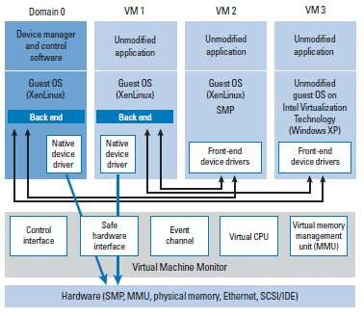

Slide 27

It is more modernized than KVM, user friendly
and can run without hardware support
Support for multiple hardware platforms
High security isolation features, independent of operating systems
Offers paravirtualization and hardware
assisted virtualization
A different, user-friendly interface
It is not included in Linux except in recent versions
It has minimal power management features
It has a different dom0 structure
increasing overload on CPU.
More complex than other hypervisors
pros
cons

Slide 28
Kernel Virtual Machine
Kernel-based Virtual Machine (KVM) is an open source virtualization technology built into Linux®. Specifically, KVM lets you turn Linux into a hypervisor that allows a host machine to run multiple, isolated virtual environments called guests or virtual machines (VMs).

Slide 29
How does KVM work?
KVM converts Linux into a type-1 (bare-metal) hypervisor. All hypervisors need some operating system-level components—such as a memory manager, process scheduler, input/output (I/O) stack, device drivers, security manager, a network stack, and more—to run VMs.
KVM has all these components because it’s part of the Linux kernel. Every VM is implemented as a regular Linux process, scheduled by the standard Linux scheduler, with dedicated virtual hardware like a network card, graphics adapter, CPU(s), memory, and disks.

Slide 30
Implementing KVM
Linux that was released after 2007 and it needs to be installed on X86 hardware that supports virtualization capabilities.
Load 2 existing modules (a host kernel module and a processor-specific module), an emulator, and any drivers that will help you run additional systems.

Slide 31
KVM features
KVM is part of Linux. Linux is part of KVM. Everything Linux has, KVM has too. But there are specific features that make KVM an enterprise’s preferred hypervisor.
Security
KVM uses a combination of security-enhanced Linux (SELinux) and secure virtualization (sVirt) for enhanced VM security and isolation. SELinux establishes security boundaries around VMs. sVirt extends SELinux’s capabilities, allowing Mandatory Access Control (MAC) security to be applied to guest VMs and preventing manual labeling errors.

Slide 32
Storage
KVM is able to use any storage supported by Linux, including some local disks and network-attached storage (NAS). Multipath I/O may be used to improve storage and provide redundancy.
KVM also supports shared file systems so VM images may be shared by multiple hosts. Disk images support thin provisioning, allocating storage on demand rather than all up front.

Slide 33
Hardware support
KVM can use a wide variety of certified Linux-supported hardware platforms. Because hardware vendors regularly contribute to kernel development, the latest hardware features are often rapidly adopted in the Linux kernel.

Slide 34
Memory Management
KVM inherits the memory management features of Linux, including non-uniform memory access and kernel same-page merging.
The memory of a VM can be swapped, backed by large volumes for better performance, and shared or backed by a disk file.

Slide 35
Support Migration
KVM supports live migration, which is the ability to move a running VM between physical hosts with no service interruption. The VM remains powered on, network connections remain active, and applications continue to run while the VM is relocated. KVM also saves a VM's current state so it can be stored and resumed later.

Slide 36
Performance and scalability
KVM inherits the performance of Linux, scaling to match demand load if the number of guest machines and requests increases.
KVM allows the most demanding application workloads to be virtualized and is the basis for many enterprise virtualization setups, such as datacenters and private clouds (vi

Slide 37

NPT/EPT support (server boost)
KSM (share memory with COW)
Disk image cloning, sharing, snapshot
Ballooning
Live migration (nfs as shared storage)
Save and restore VM
Virtio paravirtualization
PCI-passthrough VT-D/IOMMU support

Slide 38

Each virtual CPU appears as a regular Linux process
Emulation is handle by a modified version of QEMU
Linux as a VMM
Resource management
The KVM control interface
Emulation of hardware

Slide 39
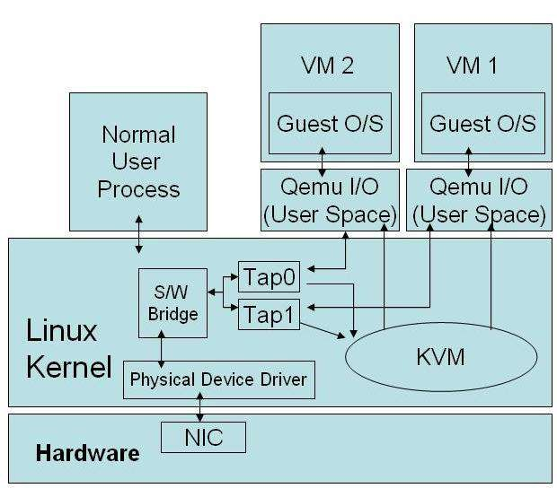

Slide 40

It is free.
It is a part of Linux
Powerful CPU virtualization on Intel and AMD platforms, leverages hardware virtualization and Linux kernel, memory management, I/O capabilities
Real time scheduling
Powerful GUI
Powerful command line scripting tools for better
productivity
Leverages security, kernel capabilities and memory managemnt of Linux
A bit dated
Difficult to master for novices and those used
to GUI based usage
Very slow when CPU does not support virtualization and when it works in QEMU mode
Heavy I/O overhead
Lack of flexibility in device assignment
Issues in memory and power management
pros
cons

Slide 41





Slide 42







Host operating system support(virtualbox is better)
Ease of editing virtual machine’s configuration (virtualbox is better) Usb support (vmware is better)
Range of virtual hard disks (virtualbox is better)
Remote connections (virtualbox is better) VM cloning (virtualbox)

Slide 43
Ease of boot (vmware is better)
USB over RDP (virtualbox is better)
"Teleportation" migration functionality.(virtualbox is better)
Command-line options.(virtualbox is better)
Graphics(VMware is better)
Ovf support(vmware is better)

Slide 44


HOST OS - KVM isn't an option on older CPUs made before the virtualization extensions were developed, and it rules out newer CPUs (like Intel's Atom CPUs) that don't include virtualization extensions.
Red Hat drops XEN and anoints KVM
Market of KVM and XEN - If you're going with RHEL over the long haul, bank on KVM. If you're running on Amazon's EC2, you're already using Xen, and so on
Operating system overhead - Xen is not burdened with any operating system overhead that is unrelated to processing a series of guests on a given machine
Security - Xen ensures a high level of security via a variety of methods/features: guest isolation,priviliged access, small code base and operating system seperation

Slide 45
Maturity - The Xen hypervisor has been available for enterprise deployment since 2004 and is the first open source hypervisor to successfully be deployed by industry leading Linux vendors
Scheduling -Xen uses its own kernel for thread scheduling and dispatching virtual machines, while KVM, accepted into mainline Linux kernel sources, uses that kernel for these operations
Ease of use - KVM is generally considered easier to configure and operate given it is just a single module that you load in the Linux kernel.
Memory page sharing -XEN doesn't implement memory page sharing and KVM does it very efficiently.
Lack of Dom0 in kvm -KVM introduces many performance benefits, such as less I/O latency due to lack of Dom0
I/O and network operations –
Kvm- VM -> Virtio -> CentOS with KVM
XEN- VM -> PV-OPS Driver -> Dom0 -> Xen

Slide 46


CPU speed
Cache and Memory speed
i/o Disk access speed
Network Speed
Cryptography speed

Slide 47
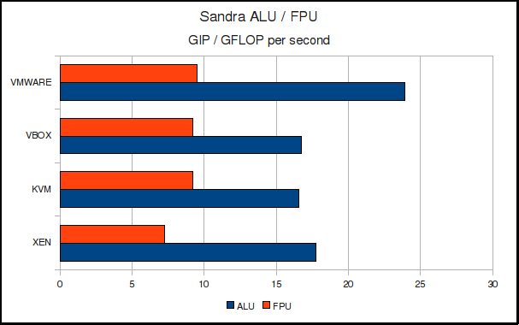


 | VMware | VirtualBox | KVM | Xen
SSE | yes | yes | Yes | yes
SSE2 | yes | yes | Yes | yes
SSE3 / SSSE3 | yes / yes | yes / no | yes / no | yes / yes
SSE4 | yes | no | no | yes
VMware takes the lead in both ALU and FPU performance, but it is the integer speed which shows the higher advantage.
Only VMware and Xen present to the guest OS the SSSE3 and newer extensions.
The net result is that VirtualBox and KVM are on par with VMware, while Xen show some problems giving a considerably lower result.

Slide 48






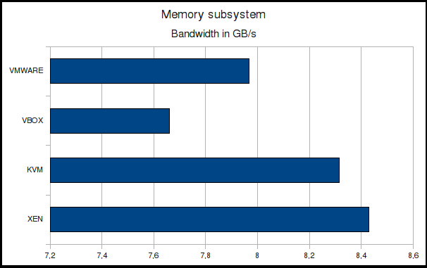
While VMware, VirtualBox and KVM give us quite similar in results, Xen is behind the competitors. This can be a results of a more-heavy hypervisor or, more probably, of the “double
encapsulation” of the guest system
The story is reversed now: Xen is slight faster, and least VirtualBox.
It seems that Xen do a very good use of the nested page table feature.

Slide 49
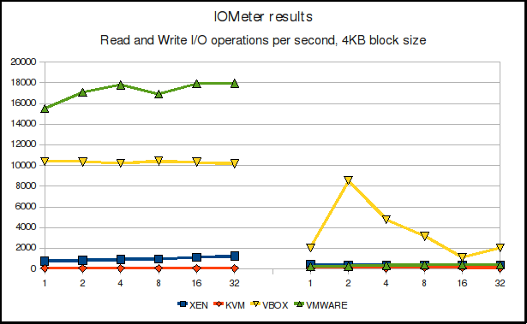
KVM is, by much, the slower hypervisor in the read test; VMware is best.
To us, the KVM results are due to very poor caching and great I/O overhead.

Slide 50




Watching the write test, we have a very different picture: the faster virtual machine is VirtualBox
To us, seems that VirtualBox use a write-back cache algorithm, while the others use a write- throught policy.
greater speed for VirtualBox, but also a greater risk of data loss
 | 1 | 2 | 4 | 8 | 16 | 32
XEN | 410,28 | 367,6 | 370,37 | 374,77 | 376,66 | 376,78
KVM | 108,52 | 107,22 | 105,81 | 109,3 | 107,17 | 95,8
VBOX | 2022,38 | 8548,59 | 4756,33 | 3162,37 | 1120,3 | 2044,4
VMWARE | 216,63 | 267,01 | 332,63 | 361,53 | 359,8 | 393,46

Slide 51


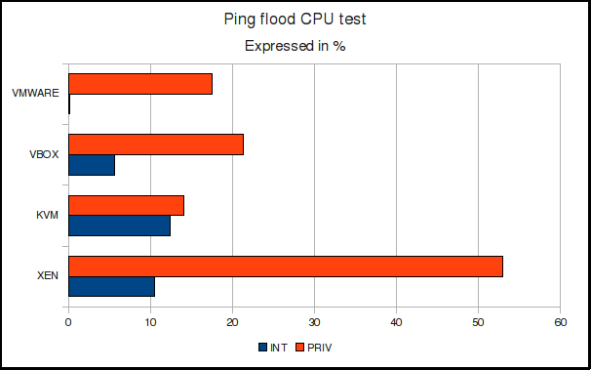
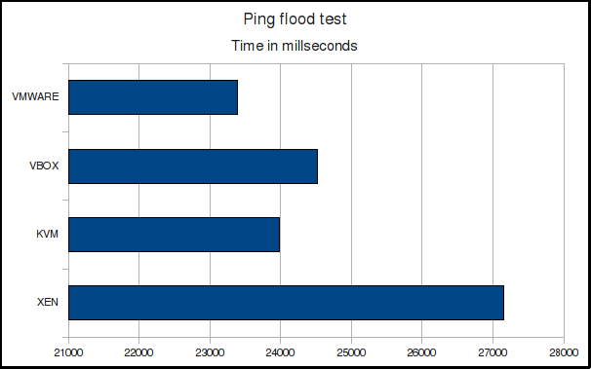
· ping -f 192.168.122.166 -c 25000 -s 1024
The results are quite close, with Xen only slight slower
We can see that KVM was the best performing virtual machine, with a privileged time dominated by IRQ servicing time: this means that the network-related syscalls executed quite fast on KVM. On contrary, Xen has a very high privilege time but a lower IRQ time: the network-related syscalls executed slowly. VMware as a extraordinary low IRQ time, probably a courtesy of its paravirtualized network driver, while VirtualBox is overall a decent performer.

Slide 52

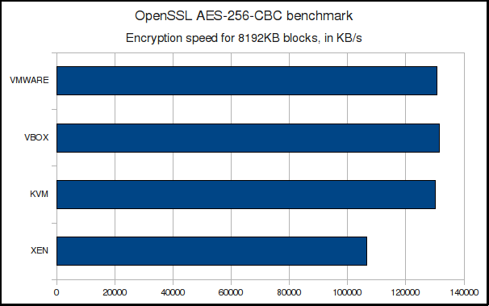

Slide 53
Installation time
Web server test
Mysql performance
FTP server test
File compression/ Decompression test

Slide 54


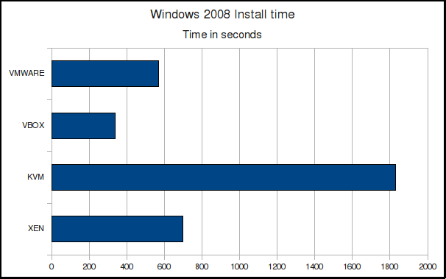
· VMware and Xen are very closely matched, while KVM is the real loser: it took over 30 minutes to complete, a 5-fold increase compare VirtualBox!
d to

Slide 55


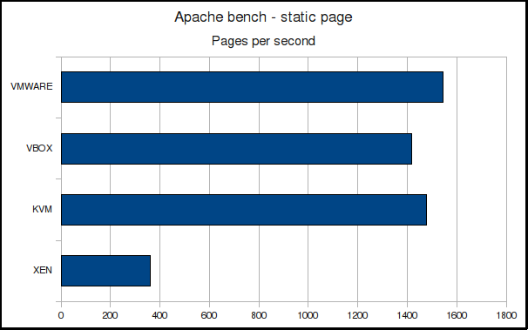
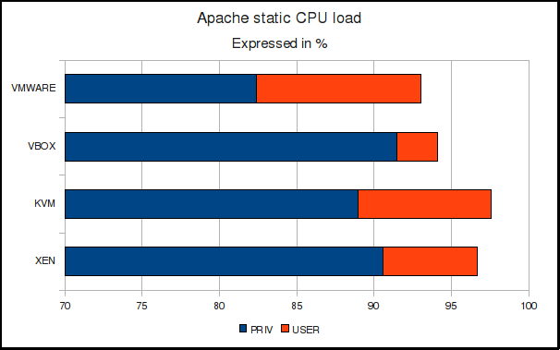
1. Xen is really slow, the othe hypervisors perform quit similarly here. As Apach creates a new thread f each new connection, it i entirely possible that the rea culprit here is a very lo speed in creating ne threads.
r e e or
s
l w w
2. VirtualBox seems to be the best user-level hypervisior, but it lag behind in kernel-level CPU time. At the other end, VMware has great kernel- level CPU time but the worst user-level time.
Xen is the slowest machine, while VMware is the fastest.

Slide 56
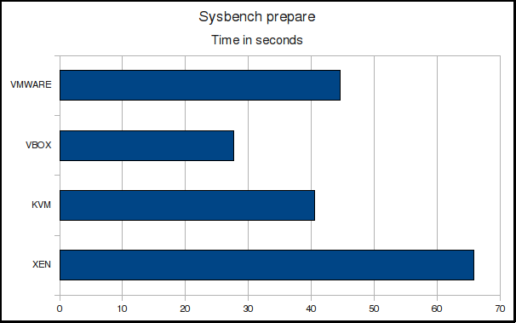
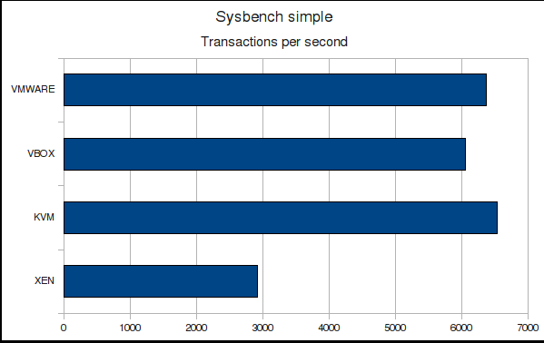
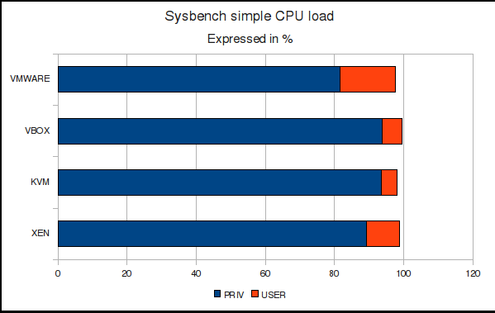



1. Xen was the slowest machine, while VirtualBox was the fastest
2. Xen is again the slowest hypervisor, with a very great gap from the other. Well, it seems that we were right: MySQL is another well-threaded program, and Xen results are very low. On the other hand, KVM is a little faster that the others.
3. We see a very great dominance of privileged (kernel) time. It means that the system spend the most time on syscalls or IRQ servicing routines.

Slide 57
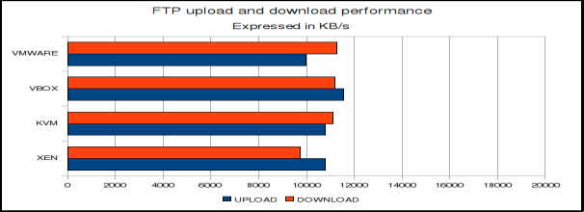
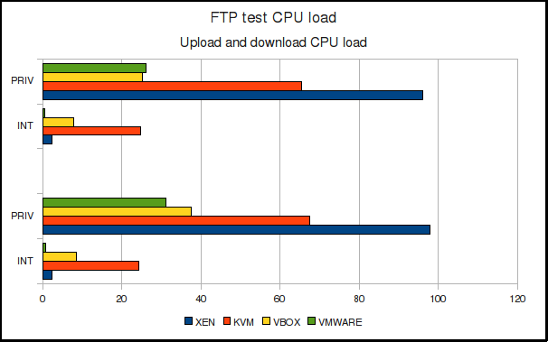
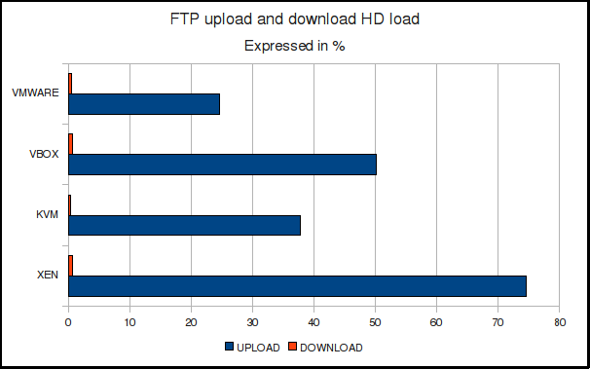


1. Xen-best- download vmware-best-upload
2. The results are not so homogeneous now: Xen is the least efficient hypervisor here showing syscall routines execute very slowly.
3. The download disk activity is so small thanks to the guest side caching. VMware is the most efficient machine, Xen is the least.

Slide 58
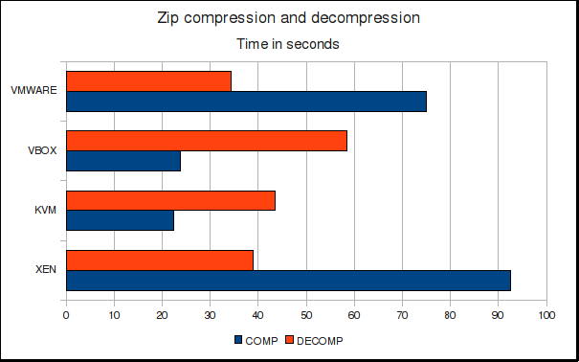
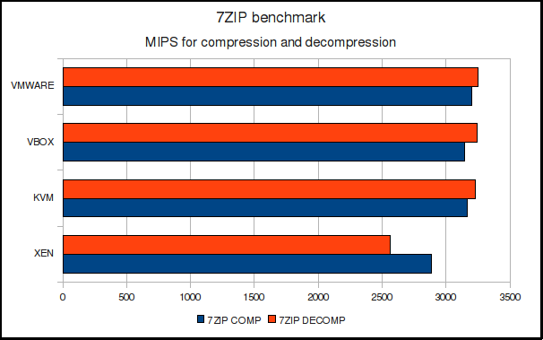




1. Apart Xen, which is slower, VMware, VirtualBox and KVM are quite paired each other.
KVM is very fast to both compressing and decompressing.
compression test, which is more CPU intensive, KVM and VirtualBox both have a quite strong advantage. In the decompression test, which is generally disk bound, we see that KVM lost the crown probably as a result of its no-so-quick disk subsystem, while Xen and VMware are slightly better.

Slide 59


Test | Best | Worst
Cpu speed | Vmware | Xen
Cache subsystem | Vmware | Xen
Memory subsystem | Xen | Vbox
I/O speed | Vbox | KVM
Network speed | KVM | Xen
Cryptographic speed | Vmware, KVM, Vbox | Xen
Installation time | Vbox | KVM
Web server test | Vbox followed by vmware | Xen
Sql server test | KVM | Xen
FTP server test | Vmware | Xen
Compression/ Decompression speed | KVM / Vmware | Xen / Vbox

Slide 60



